Slide 1
A Power Control MAC Protocol for Ad Hoc Networks by Eun-sun Jung and Nitin H. Vaidya
ACM MOBICOM 2002
Myungchul Kim
mck@kaist.ac.kr

Slide 2
Abstract
A power control MAC protocol of IEEE 802.11 to vary transmit power level on a per-packet basis in order to save energy and not to degrade throughput

Slide 3
Introduction
Wireless hosts powered by batteries -> reduce energy
  Use power saving mechanisms: allow a node to a doze state
  Use power control schemes: vary transmit power to save energy and improve spatial reuse of the wireless channel
In this paper, power control for the purpose of energy saving
Extended IEEE 802.11 power control: RTS and CTS using the highest power level and DATA and ACK using the min power level -> increases collision and degrades network throughput

Slide 4
Related work
Paper [15]
  A node, A, to specify its current transmit power level in the transmitted RTS, and allows receiver node B to include a desired transmit power level in the CTS sent back to A
  On receiving the CTS, node A then transmits DATA using the power level specified in the CTS
Paper [6]
  The RTS and CTS packets are sent at the highest power level, and the DATA and ACK may be sent at a lower power level
  BASIC power control MAC protocol

Slide 5
Related work
PARO [6]
  Determines routes which consume low energy
  Uses a power control MAC protocol similar to BASIC
Paper [1]
  Similar to the BASIC
  Maintains a table for the min transmit power with neighbors nodes
  Different power levels among nodes result in asymmetric links, causing collisions

Slide 6
Related work
Paper [28]
  Uses one control channel and multiple data channels
  The control channel using the highest transmit power
  DATA and ACK transmissions occur on the reserved data channel using the negotiated power level from the RTS-CTS handshake
Paper [4, 5]
  Transmit power is controlled according to packet size
Paper [14]
  Unfairness for nodes using lower transmission power than their neighbor nodes

Slide 7
Related work
Paper [13]
  Selects a common power level at all nodes in the networks to ensure bi-directional links
Paper [12]
  Power Controlled Multiple Access [PCMA]
  Allows different nodes to have different transmission power levels
  Uses two channels: one for “busy tones” (to overcome the hidden terminal problem) and the other for all other packets
  While a node is receiving a DATA packet, it periodically sends a busy tone
  Busy tones with two separate channels in papers

Slide 8
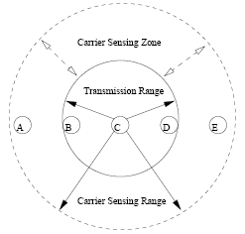
IEEE 802.11 MAC Protocol
PCF (point coordination function) and DCF (distributed coordination function)
DCF in this paper
Fig 1
Transmission range: max 250 m, Carrier sensing range: max 550 m, Carrier sensing zone: can sense the signal but cannot decode it correctly.

Slide 9
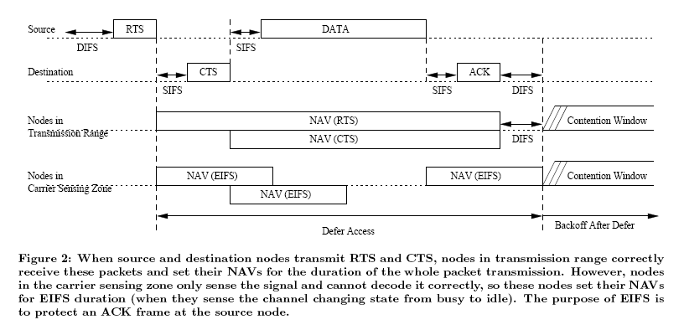
IEEE 802.11 MAC Protocol
Fig 2

Slide 10
IEEE 802.11 MAC Protocol
DCF is based on CSMA/CA
Carrier Avoidance is performed using physical carrier sensing as well as virtual carrier sensing
Virtual carrier sensing: uses the duration of the packet transmission of RTS, CTS and DATA frames
Each node maintains a NAV (network allocation vector) which indicates the remaining time of the on-going transmission sessions.
EIFS is to provide enough time for a source node to receive the ACK frame -> the duration of EIFS is longer than that of an ACK transmissions.
EIFS = SIFS + DIFS + [(8 * ACKsize) + PreambleLength + PLCPHeaderLength]/BitRate = 364 micro sec using a 1 Mbps channel bit rate

Slide 11
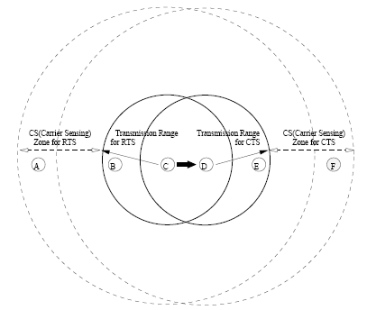
IEEE 802.11 MAC Protocol
IEEE 802.11 does not completely prevent collisions due to a hidden terminal
Carrier sensing range for RTS-CTS is the same as that of DATA-ACK since transmit power does not change
Node F

Slide 12
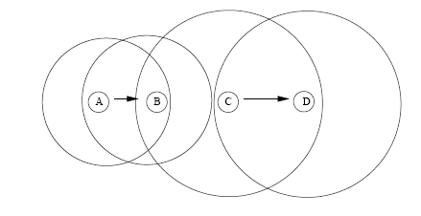
Basic Power Control Protocol
Different transmission power -> increased collisions
Fig 4

Slide 13
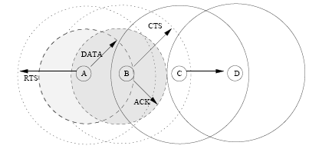
Basic Power Control Protocol
Basic scheme: RTS and CTS at the highest possible power level but DATA and ACK at the min power level
Fig 5

Slide 14
Basic Power Control Protocol
Basic scheme
  RTS with p_{max} is sent and received with p_{r}
  Receiver can calculate the min necessary transmission power level, p_{desired} for the DATA packet [12] taking into account the current noise level at receiver
  Alternative way: RTS is responded by sending a CTS as usual. The source node calculates p_{desired} based on the received power level.
  Assumptions
    Signal attenuation between source and destination nodes is the same in both direction.
    Noise level at the receiver is below some predefined threshold.

Slide 15
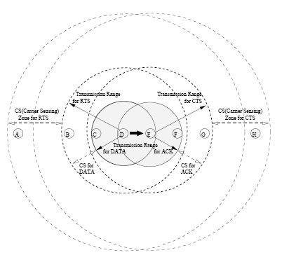
Basic Power Control Protocol
Deficiency
  The transmission range (and carrier sensing zone) for DATA-ACK is smaller than that of RTS-CTS
  Nodes A and H

Slide 16
Proposed Power Control MAC Protocol
The procedure in PCM
  Source and destination nodes transmit the RTS and CTS using p_{max}. Nodes in the carrier sensing zone set their NAVs for EIFS duration when they sense the signal and cannot decode it correctly.
  The source node may transmit DATA using a lower power level, similar to the BASIC scheme.
  To avoid a potential collision with the ACK, the source node transmits DATA at the power level p_{max}, periodically, for just enough time so that nodes in the carrier sensing zone can sense it.
  The destination node transmits an ACK using the min required power to reach the source node, similar to the BASIC scheme.

Slide 17
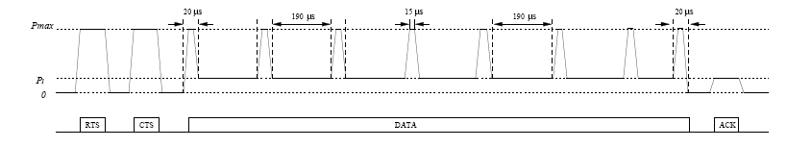
Proposed Power Control MAC Protocol
Fig 7
Since nodes that can sense a transmission but not decode it correctly only defer for EIFS duration, the transmit power for DATA is increased once every EIFS duration.
EIFS = 212 microsec using a 2 Mbps bit rate, a node transmits DATA at p_{max} every 190 microsec for a 20 microsec duration.

Slide 18
Performance evaluation
Metrics
  Aggregate throughput over all flows
  Total data delivered per unit of transmit energy consumption (or, Mbits delivered per joule)
Simulation model
  ns-2 with the CMU wireless extension
  2 Mbps for the channel bit rate
  512 bytes
  CBR flow
  Two-ray path loss model for the radio propagation model (no fading)
  250 m transmission range and 550 m carrier sensing range at the max transmit power level

Slide 19
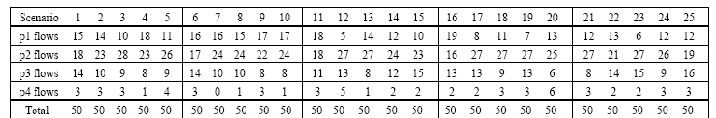
Performance evaluation
Simulation topology
  Chain topology
  Fig 8
  Random topology
  50 nodes within a 1000 * 1000 m²
  50 flows
  Table 1(50Scenarios)

Slide 20
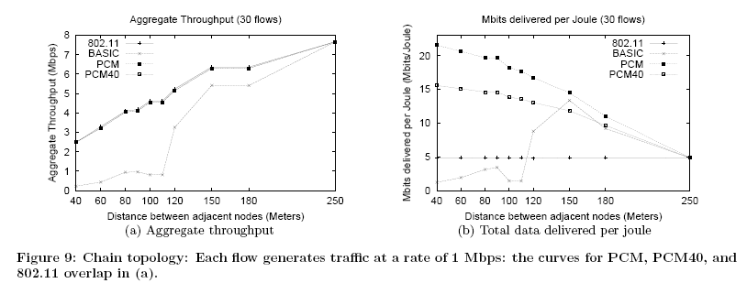

Performance evaluation
Simulation results
  Chain topology
  Fig 9, Table 2

Slide 21
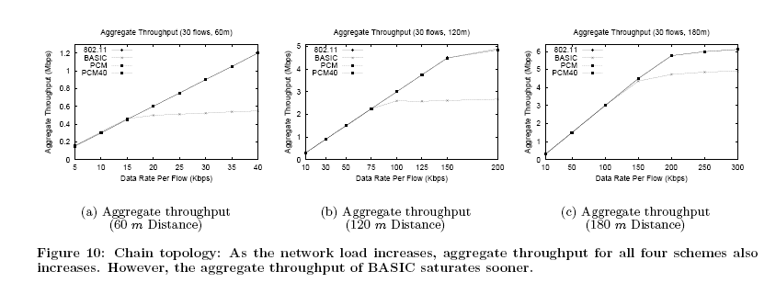
Performance evaluation
Simulation results
  Chain topology: varying network load
  Fig 10

Slide 22
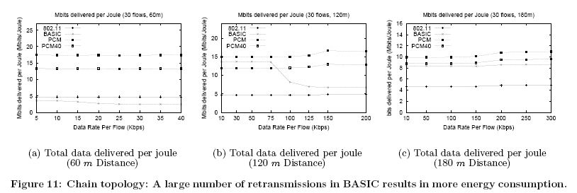
Performance evaluation
Simulation results
  Chain topology: varying network load
  Fig 11

Slide 23
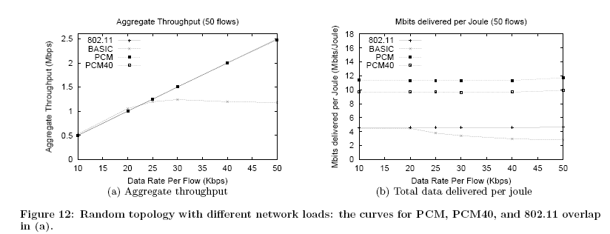
Performance evaluation
Simulation results
  random topology: varying network load
  Fig 12

Slide 24
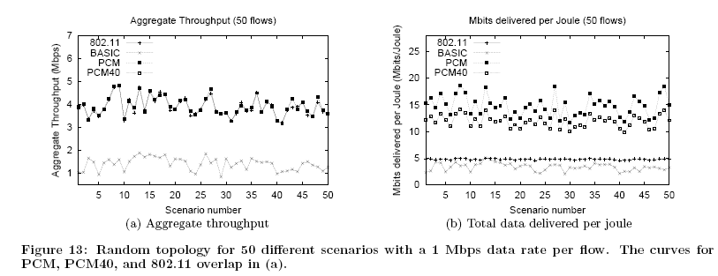
Performance evaluation
Simulation results
  random topology: 50 different topologies
  Fig 13

Slide 25
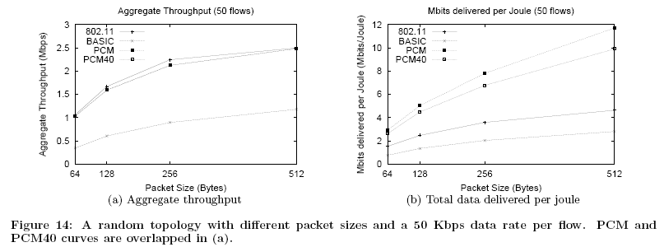
Performance evaluation
Simulation results
  random topology: varying packet size
  Fig 14

